Slide 1
PG4200: Algorithms And Data Structures Lesson 11: Genetic Algorithms and Randomness
Prof. Andrea Arcuri

Slide 2
Nature Inspired Algorithms
Nature is good at solving many different problems
Idea: get inspiration from natural phenomena to create effective optimization algorithms
E.g., carbon-to-diamond process: high temperature in Earth's mantle, cooled slowly while raising up to surface
Simulated Annealing Algorithm
E.g., behavior of ants seeking a path between their colony and a source of food, based on pheromone trails
Ant Colony Optimization Algorithm

Slide 3
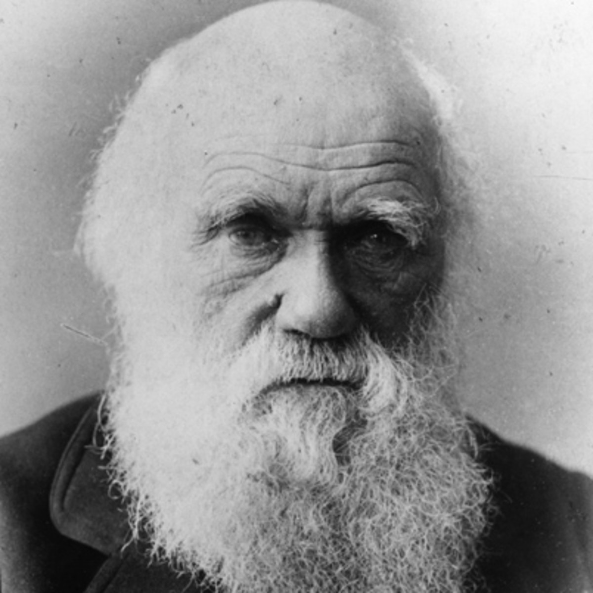
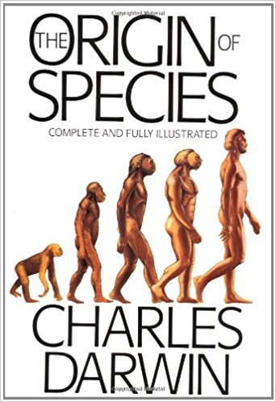
Theory Evolution
Charles Darwin, “The Origin of Species”, 1859
Theory describing how different species evolved from unicellular organisms

Slide 4
Evolutionary Algorithms (EAs)
EAs are optimization algorithms based on the theory of evolution
(1+1) EA: the simplest EA
Genetic Algorithms: the most popular EA
But there are more…

Slide 5
(1+1) EA
Mimic the evolution of a single individual that reproduces asexually, giving birth to only one offspring
Ie, 1 individual that produces 1 offspring
Evolution is driven by mutations in the chromosome of the offspring
Kill the offspring if worse than parent, otherwise kill parent after birth
Yep, evolution can be cruel…

Slide 6
Representation
The solutions in your problem space are the individuals you want to evolve
Eg queen positions on board
Chromosome: the actual representation of the individual
Eg, binary array 0/1 for knapsack problem
Mutation: similar to neighborhood in Hill Climbing, it samples new similar individuals

Slide 7
Mutation in 0/1 Sequence
1 | 1 | 0 | 0 | 0 | 1 | 0 | 1 | 0 | 0
Mutation: given N bits, each bit can be flipped with probability 1/N
Eg 10% probability in the above example
On average, only 1 bit is flipped per mutation operation
Non-zero probability to jump to any solution in the search space with a single mutation operator
ie, all bits can be flipped, although with low probability (1/N)^N
Reason: small modifications on average, but allow larger jumps to escape from local optima

Slide 8
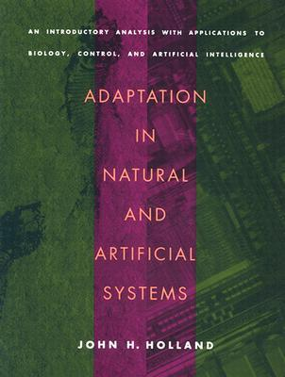
Genetic Algorithms (GAs)
1950s: Turing proposed use of evolution in computer programs
1970s: John Holland created GAs to address optimization problems
Simulate evolution of an entire population of individuals, which procreate sexually

Slide 9
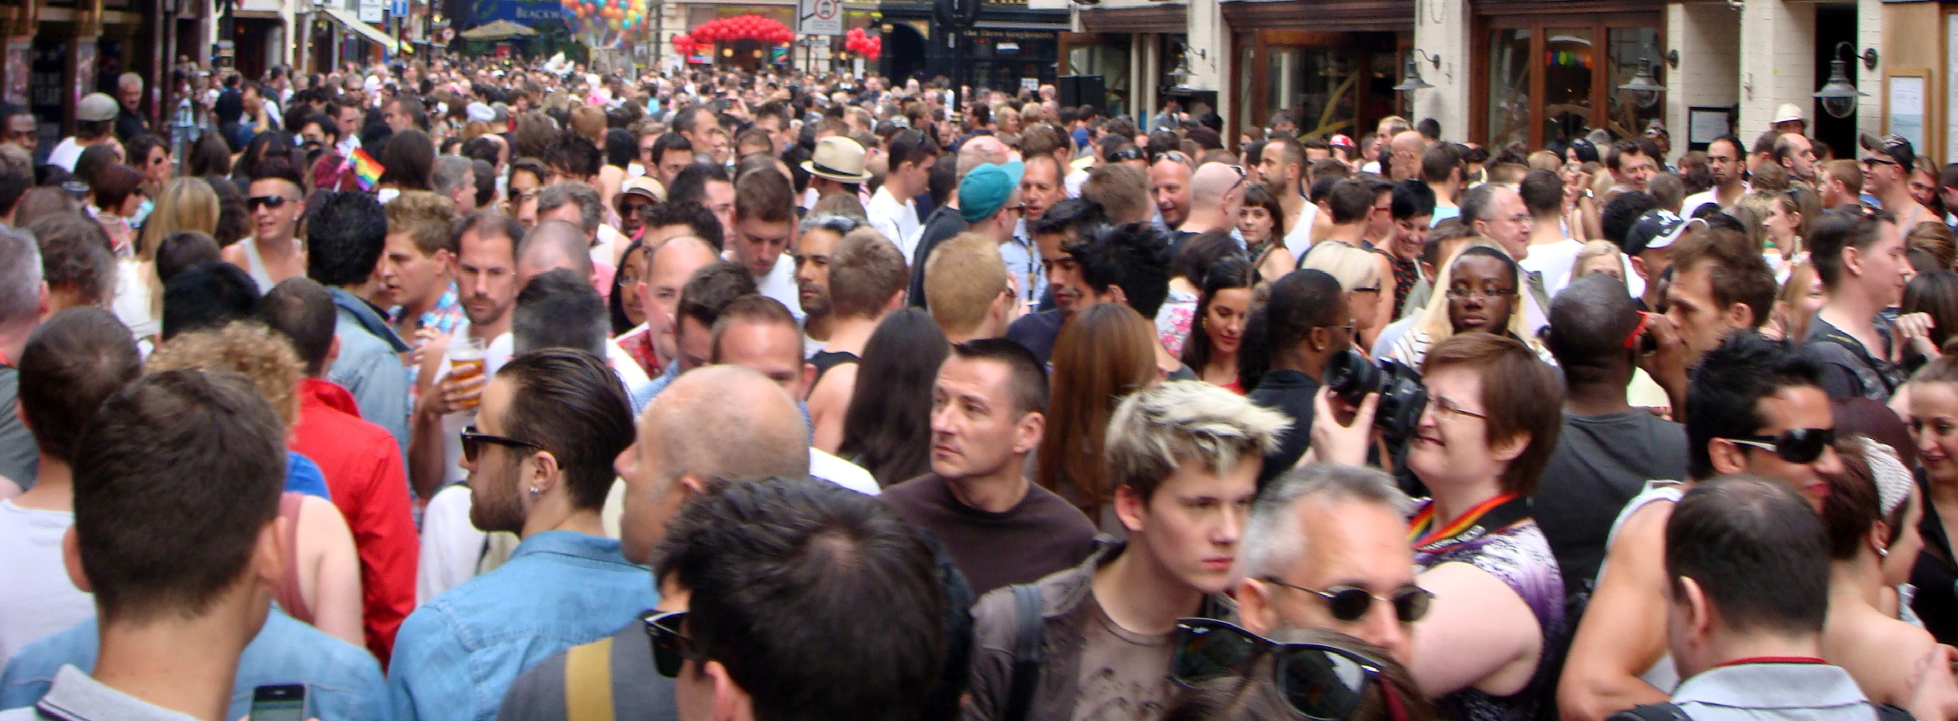
Population
Keep track of K individuals
Eg, stored in an array
At the end of search, return the best solution in the population

Slide 10

Generation
The search will be composed of 1 or more generations
At each generation, select individuals for reproduction
Create a new generation of same size K
Kill the previous generation
Yes, evolution is really cruel…
Note: given same amount of fitness evaluations Z or time budget, a larger population K means less generations G, ie Z = K * G

Slide 11
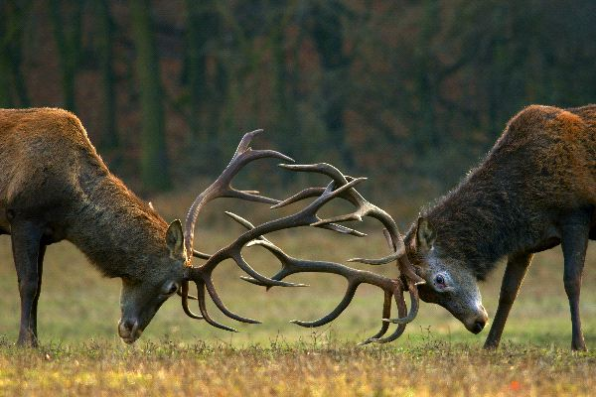
Selection
The fittest individuals will have higher chances of reproduction
Different strategies for parent selection
Tournament Selection: sample T individuals randomly from the population, and choose the best among them (according to the fitness function)

Slide 12

Sexual Reproduction
Select 2 parents, which give birth to 2 offspring
Note, ignoring gender here…
Offspring will share genetic material with their parents, via the crossover operation (aka xover)
After xover, offspring still have chances of getting mutated

Slide 13
Crossover
Parent 1
1 | 1 | 0 | 0 | 0 | 1 | 0 | 1 | 0 | 0
Parent 2
0 | 1 | 0 | 1 | 0 | 1 | 0 | 0 | 0 | 1
Choose a splitting point, eg the middle of the chromosomes
Offspring 1
1 | 1 | 0 | 0 | 0 | 1 | 0 | 0 | 0 | 1
Offspring 2
0 | 1 | 0 | 1 | 0 | 1 | 0 | 1 | 0 | 0

Slide 14
Xover Issues
In some domains, there are constraints in the representation
Eg, recall example of queen positions
A xover could lead to invalid offspring
Two options:
Kill them
Try to repair them

Slide 15
Elitism
You do not want to lose your best individuals
Unlucky in (tournament) selection
Negative mutations
At each generation, copy the best B individuals over the next generation, without xover or mutation
Even in evolution, some elite individuals still cheat the system and get preferential treatment…

Slide 16
Does this “crazy” stuff actually work???

Slide 17
Usage
Genetic Algorithms are among the most used kind of optimization algorithms
Successfully used in a lot, a lot of different domains
Goldberg’s 1989 book on GAs is among the most cited books in the whole field of Computer Science

Slide 18
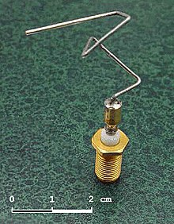
Example
Evolution of antenna designs
Optimize beamwidth and impedance bandwidth
Best found with an Evolutionary Algorithm
Used for example in NASA spacecrafts

Slide 19
More…
There is of course much more… we just scratched the surface
Tradeoff exploration vs exploitation of search landscape
Landscape Analysis
Parameter tuning
Multi-Objective Optimization of conflicting goals
Genotype vs Phenotype
Population diversity
Etc. etc.

Slide 20
Which Algorithm to Use?
Due to NFL, it depends on the problem
(1+1)EA is an easy to write algorithm, which gives good performance on many different kinds of real-world problems
If you want to use some existing library for Java, look at ECJ and jMetal

Slide 21
Randomness

Slide 22
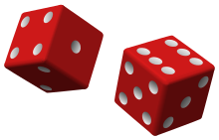
Definition
Randomness is the lack of pattern or predictability in a series of events (eg, rolling a dice)
Eg, if you rolling a dice three times, and get 4, 2, and 5, then that should give you no info about what will be value of the 4th roll
Given info of past events, should have no info to help predicting future events
Ie, events in a sequence are fully independent

Slide 23
Why You Need Randomness?
Video games
Optimization algorithms
Eg, recall random restarts in Hill Climbing
Security algorithms
Scientific applications
Etc.

Slide 24

A 6 ten times in a row???
If dice is fair, getting a specific value would have probability 1/6
Getting a 6 ten times would have probability (1/6)^10
Low probability, but not impossible
Could such sequence of 10 events come from a random generator?
In theory it can be, as such sequence is possible

Slide 25
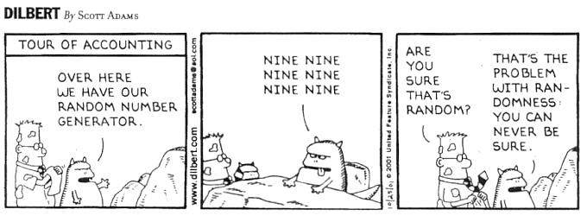
Improbable Events Can Still Happen

Slide 26
How to Get Random Numbers in Java?
java.util.Random
Fast, but not particularly good. However, fine for most basic applications
java.security.SecureRandom
Slower, but much better. Can be used in security contexts

Slide 27
Random Sources
How to create a random sequence? (eg, of integers)
Natural phenomena
Atmospheric noise, thermal noise, electromagnetic and quantum phenomena, etc.
Expensive to collect such info
Pseudo-Random Generators
Algorithms that create sequences that look like random
Not truly random, but can be enough random for your needs

Slide 28
Array Implementation
7 | 2 | 4 | 1 | 1 | 3 | 7 | 1 | 4 | 9
Create manually an array with random-like values
Keep and index of current value
When client asks for random value, return the one in index position, and increase the index by 1
When reaching end of array, start from beginning

Slide 29
Seed
In previous random generator, first queried value is always 7
Seed: starting point of the index
Eg, “index = seed % N”
Where N is the size of the array
Seed could be chosen based on current time, eg given by the CPU clock

Slide 30
Issues
Calling 30 times, starting from seed 2: 4,1,1,3,7,1,4,9,(7),2,4,1,1,3,7,1,4,9,(7),2,4,1,1,3,7,1,4,9,(7),2
Although the first N elements might look random, such sequence of N elements repeats itself
Given the knowledge of a sampled value, I can predict what would be next
From a 2 always follows a 4
From a 7, either a 1 or a 2 might follow
Using an array with a large enough N would take a lot of space…

Slide 31
Linear Congruential Generator (LCG)
The algorithm used in java.util.Random
$X_{i+1}=\left(aX_{i}+c\right) \% m$
This recursive function provides a new “random” value $X_{i+1}$ from a previous $X_{i}$, where $X_{0}$ is the initial seed
Care needs to be taken to choose good “a” and “c” values, as to get longest period P as possible
In such sequence, values from 0 to m-1 can be sampled
Think about it as an array with length P, but without the memory overhead

Slide 32
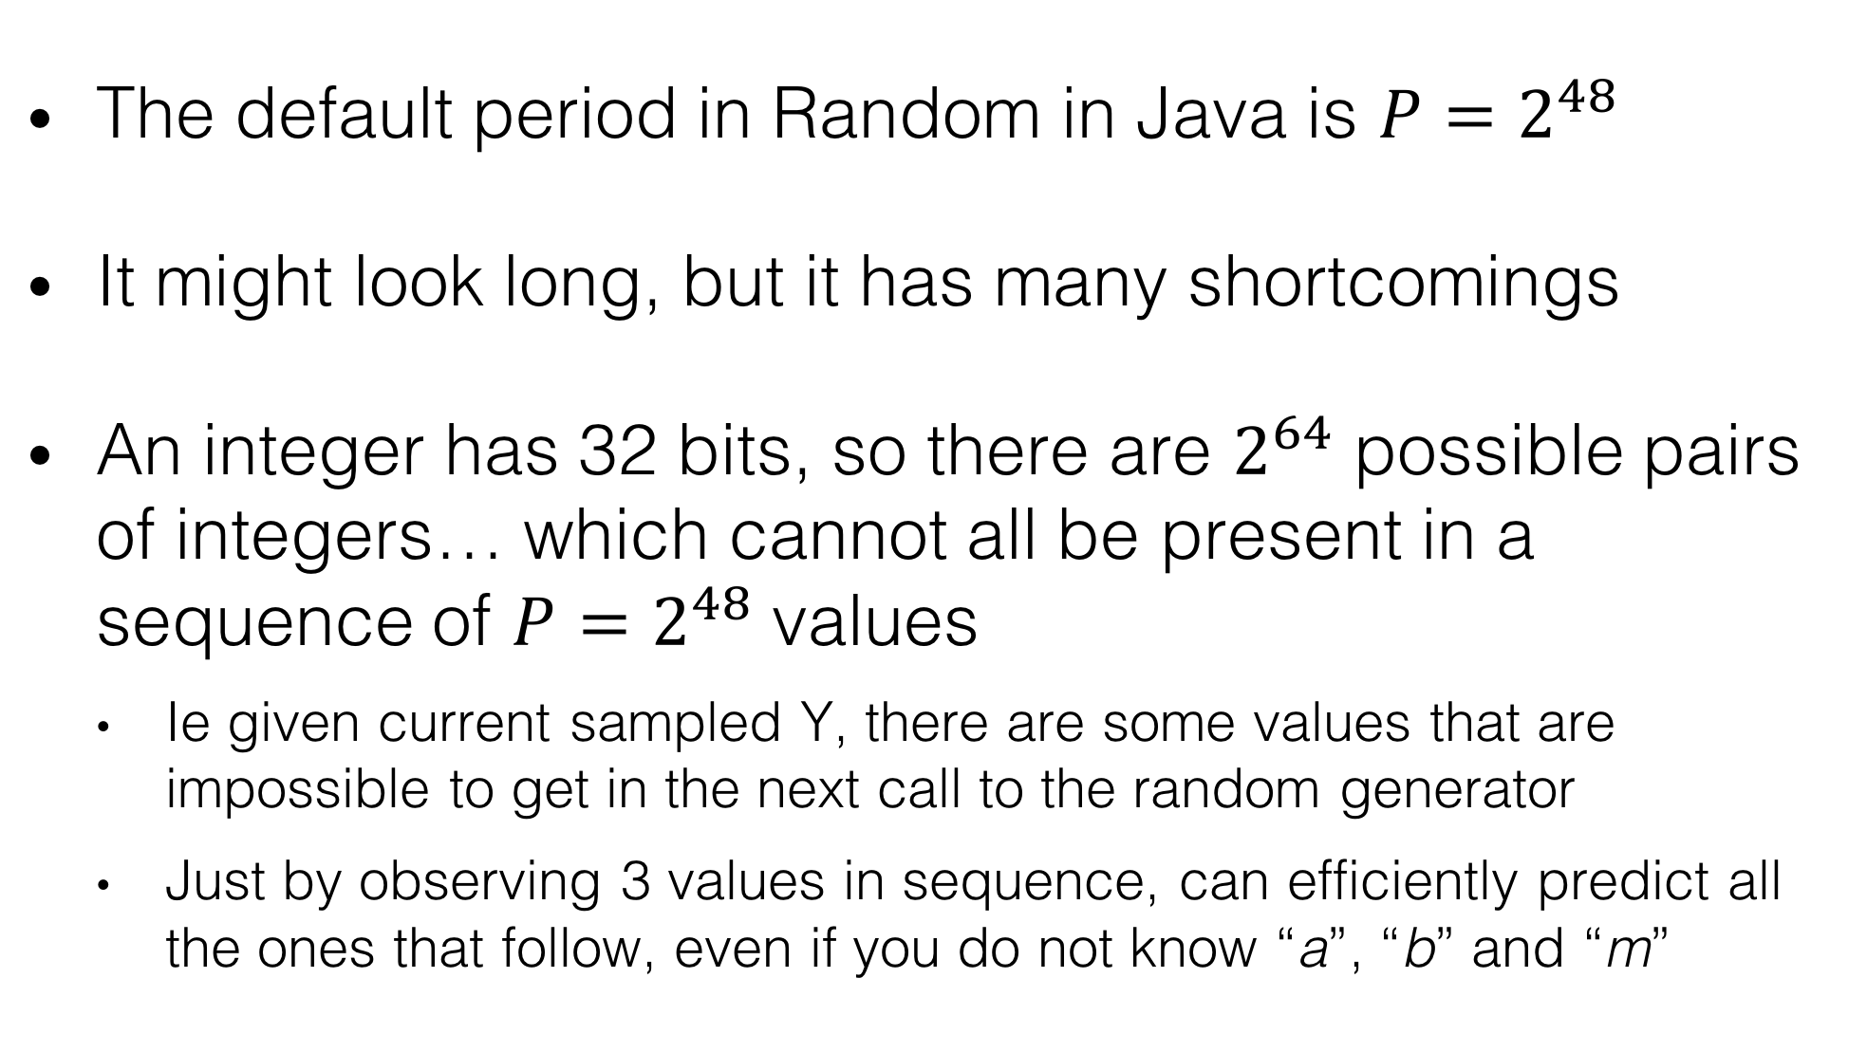
LCG in Java
The default period in Random in Java is ${P=2}^{48}$
It might look long, but it has many shortcomings
An integer has 32 bits, so there are $2^{64}$ possible pairs of integers… which cannot all be present in a sequence of ${P=2}^{48}$ values
Ie given current sampled Y, there are some values that are impossible to get in the next call to the random generator
Just by observing 3 values in sequence, can efficiently predict all the ones that follow, even if you do not know “a”, “b” and “m”

Slide 33
More Advanced Algorithms
Many algorithms
Usually, the better quality of sequence, the slower the algorithms
Eg, Mersenne Twister (MT) has ${P= 2}^{\text{19937}}−1$
Longer period is good, but not sufficient
Eg, MT, in its base form, is not cryptographically secure, as just need to see 624 values to predict the whole sequence

Slide 34
Random Bits
When getting a random number, if randomness is critical, you need to use all of its bits
A random generator usually does not give you guarantees on the properties of subsets of its bits in output
So, let’s say you want a number in 0-99, and so use “random() % 100” (where random gives a random positive integer)… what’s the problem with this?
Only the 7 leftmost bits out of 32 are used

Slide 35
Cont.
Those 10 elements are all unique, when consider all their 32 bits
Doing “random() % 1000” would give the sequence: 807,7,207,907,307,207,807,907,707,807
But doing “random() % 100” would give the sequence: 7,7,7,7,7,7,7,7,7,7
321,807
7
11,113,207
999,999,907
2,307
452,223,207
137,807
98,880,907
707
7,773,807

Slide 36
Homework
No Book Chapter
Study code in the org.pg4200.les11 package
Do exercises in exercises/ex11

